Slide 1
Azure Developer Camp

Slide 2

What are Containers?

Slide 3
Containers are:
Containers use resource isolation features of the Linux Kernel, such as control groups and namespaces.
All the process run and share the same kernel used by OS.
Containers are an abstraction at the app layer that package code and dependencies together.
Containers provide the application and process isolation where one application is completely unaware of the existence of another application.
Wrappers around a UNIX process that directly talks to the kernel to request and use the resources.
Notes:
Containers are a method of virtualization that packages an application's code, configurations, and dependencies into building blocks for consistency, efficiency.
A container is a standard unit of software that packages up code and all its dependencies, so the application runs quickly and reliably from one computing environment to another

Slide 4
Features of containers
Efficiency. A virtual machine feels and works like a separate machine. The key advantage is efficient resources usage and isolation from a security standpoint
Flexibility. Resources can be allocated as needed. CPUs, memory, and the like can all be distributed on an initial requirements basis and when needed.
Lightweight. Containers leverage and share the host kernel.
Interchangeable. You can deploy updates and upgrades on-the-fly.
Portable. You can build locally, deploy to the cloud, and run anywhere
Wrappers around a UNIX process that directly talks to the kernel to request and use the resources.

Slide 5
Container Architecture
Virtual Machine Architecture
C2
C2
C3
VM 1
VM 2
VM 3
App
App
App
App
App
App
Dependencies
Dependencies
Dependencies
Guest OS
Guest OS
Guest OS
Container Engine
Hypervisor
Host OS
Host OS
Server Infrastructure
Server Infrastructure

Slide 6
Why should you use containers?

Slide 7



What are microservices?
A Software Architectural Style
Monolithic
Microservices
Applications are composed of small, independent modules that communicate with each other using well-defined APIs. Not platform specific
Large, all-inclusive app
Small, independent services
App
App
App
Decoupled
These service modules are highly decoupled building blocks that are small enough to implement a single functionality but together can form larger systems
Independently versioned, deployed, & scaled
With a microservices architecture, developers can create, manage, and improve application services independently, even using different languages
Containers provide the consistent format and isolation desired by microservices
Notes:
Forget these challenge with Microservices architecture:
Performance issues
Scalability
Longer cycles for regression testing
Unscheduled downtime
Potential downtime during upgrades
Stuck with the existing technology and programming language.
No way to scale just the required components of functionality

Slide 8
Monolithic Architecture
+
-
Client
Calc(num1, num2, op)
x
%
Output
Notes:
Calculator Monolithic paradigm
In monolithic application all calculator operations, addition, subtraction and so on, may be written as separate program functions, and one function may call another function directly to complete this action.
There is only one process running.
The disadvantage on this architecture is that if a bug is encountered in any of the functions, it could take the whole application down

Slide 9
Microservices-based architecture
+
-
Client
Calc(num1, num2, op)
Output
x
%
We have only one microservice to write, compile, and deploy
Notes:
Calculator Microservices-based architecture
The microservices paradigm builds the calculator application by constructing each operation offered by the calculator as a separate standalone service
This simplicity can help in various ways:
Enabling you to add many capabilities as required
Each micro service can be independently updated or scaled on demand.
Create a new operation that uses an existing available functionality. Ex. Finding square a given number.
Compared to a monolithic application’s need for recompilation, redeployment, and so on, with possible downtime as a result.

Slide 10
Microservices-based architecture
+
-
^2
Client
Calc(int, int)
int
x
%
Square the number function easily added with New microservices
Notes:
Calculator Microservices-based architecture
The microservices paradigm builds the calculator application by constructing each operation offered by the calculator as a separate standalone service
This simplicity can help in various ways:
Enabling you to add many capabilities as required
Each micro service can be independently updated or scaled on demand.
Create a new operation that uses an existing available functionality. Ex. Finding square a given number.
Compared to a monolithic application’s need for recompilation, redeployment, and so on, with possible downtime as a result.
These microservices are deployed separately, and each performs a single function.

Slide 11
Other Advantages of Microservices:
Scalability Comparison
Simplicity. Each microservices performs only one distinct and well-defined.
Scalability. To scale a monolithic application, we need to deploy resource-heavy applications on multiple servers behind a load balancer. It is not possible to scale just a portion of an application; it is all or nothing. With microservices, we can scale out only only the components that are expected to be highly loaded.
Continuous delivery.
More freedom and fewer dependencies.
Fault isolation
Monolithic
Load Balancer
+
-
+
-
+
-
X
%
X
%
X
%
Microservices
Load Balancer
Load Balancer
+
+
-
Load Balancer
Load Balancer
X
X
%

Slide 12
Containers Vs Virtual Machines

Slide 13
Containers VS Virtual Machine
A container, on the other hand, is nothing more than a single isolated process running in the host OS, consuming only the resources that the app consumes and without the overhead of any additional processes.
VS

Slide 14
Containers VS Virtual Machine
A container runs natively on Linux and shares the kernel of the host machine with other containers. It runs a discrete process, taking no more memory than any other executable, making it lightweight.
Virtual machines (VMs) are an abstraction of physical hardware turning one server into many servers. The hypervisor allows multiple VMs to run on a single machine. Each VM includes a full copy of an operating system, the application, necessary binaries and libraries - taking up tens of GBs. VMs can also be slow to boot.
VS
Notes:
Virtual machine (VM) runs a full-blown “guest” operating system with virtual access to host resources through a hypervisor. In general, VMs provide an environment with more resources than most applications need.

Slide 15
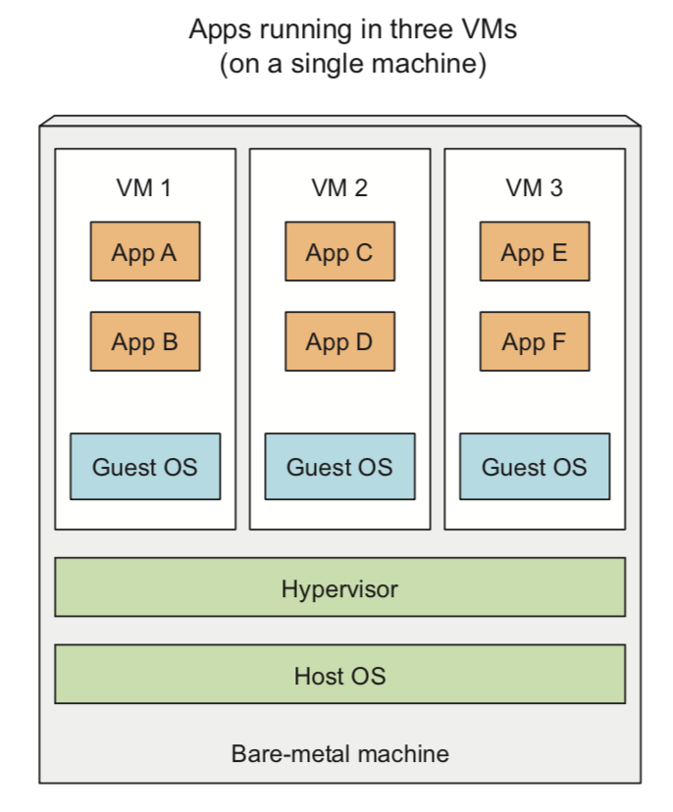
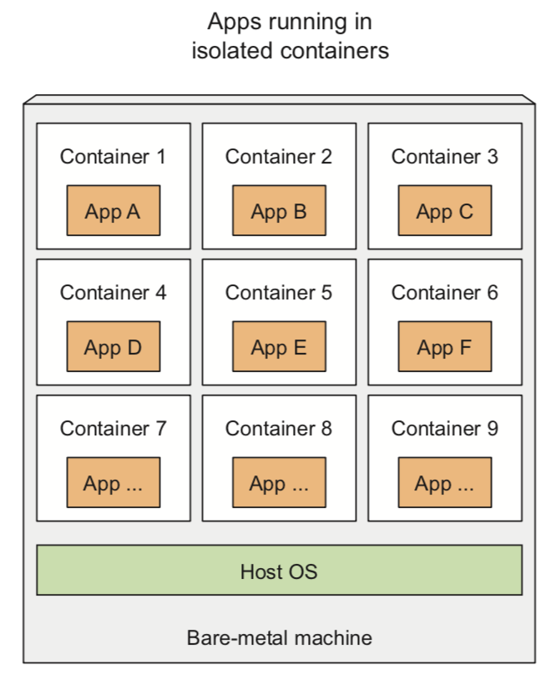
Containers VS Virtual Machine
Compared to VMs, containers are much more lightweight, which allows you to run higher numbers of software components on the same hardware, mainly because each VM needs to run its own set of system processes, which requires additional compute resources in addition to those consumed by the component’s own process.
A container, on the other hand, is nothing more than a single isolated process running in the host OS, consuming only the resources that the app consumes and without the overhead of any additional processes.

Slide 16


Continue with your own journey
Learn more about containers
Drive business agility with containers
facebook.com/MSFTDev.US
@MSDEV

Slide 17
Azure Container Instances (ACI)

Slide 18
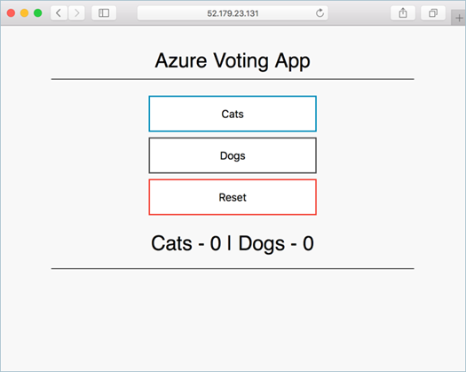
Deploy an AKS cluster using Azure CLI
Implementation steps:
1. Create a resource group:
az group create --name myAKSCluster --location eastus
2. Create an AKS cluster:
az aks create --resource-group myAKSCluster --name myAKSCluster --node-count 1 --enable-addons monitoring --generate-ssh-keys
3. Connect to the AKS cluster:
az aks get-credentials --resource-group myAKSCluster \ --name myAKSCluster
4. Create a Kubernetes manifest file (azure-vote.yaml)
5. Run the containerized application:
kubectl apply -f azure-vote.yaml
6. Monitor the progress of the deployment:
kubectl get service azure-vote-front –watch
7. Monitor health and logs (from the Azure portal)

Slide 19
Deploy an AKS cluster using Azure Portal
Implementation steps:
1. Create a resource > Kubernetes Service:
Basics: Project details, Cluster details, Scale
Authentication: A new or existing service principal and RBAC settings
Networking: Http application routing and Network configuration (Basic or Advanced)
Monitoring: A new or existing Log Analytics workspace.
2. Connect to the cluster:
az aks get-credentials --resource-group myAKSCluster \ --name myAKSCluster
3. Create a Kubernetes manifest file (azure-vote.yaml)
4. Run the containerized application:
kubectl apply -f azure-vote.yaml
5. Monitor health and logs (from the Azure portal)

Slide 20
Azure Container Registry overview
Key concepts:
Registry
Repository
Image
Container
ACR is a managed container registry based on Docker Registry 2.0:
Integrates with Azure Container Registry Build (for building container images)
Is available in three service tiers: Basic, Standard, and Premium
Offers:
Webhook integration
Azure AD authentication
Delete functionality
Geo-replication (with the Premium tier)

Slide 21
Deploy an image to ACR using Azure CLI
Implementation steps:
1. Create a resource group:
az group create --name myResourceGroup --location eastus
2. Create a container registry:
az acr create --resource-group myResourceGroup --name myContainerRegistry007 --sku Basic
3. Log in to ACR:
az acr login --name <acrName>
4. Push a new image to ACR (or pull and tag an existing image first):
docker pull microsoft/aci-helloworld
docker tag microsoft/aci-helloworld <acrLoginServer>/aci-helloworld:v1
docker push <acrLoginServer>/aci-helloworld:v1
5. Deploy a container by using an image in ACR:
az container create --resource-group myResourceGroup --name acr-quickstart --image <acrLoginServer>/aci-helloworld:v1 --cpu 1 --memory 1 --registry-username <acrName> --registry-password <acrPassword> --dns-name-label aci-demo --ports 80

Slide 22
Azure Container Instances Overview
A managed container hosting option offering a range of benefits:
Fast startup times
Public IP connectivity and DNS name
Hypervisor-level security
Custom sizes
Persistent storage
Linux and Windows containers
Co-scheduled groups

Slide 23
Implement an application using Virtual Kubelet
Virtual Kubelet provider is an experimental open source project:
Allows scheduling AKS-managed containers on Azure Container Instances
Combines functional benefits of AKS with low pricing of ACI
Supports both Windows and Linux containers
To install the Virtual Kubelet provider:
Ensure that the prerequisites are satisfied:
An existing AKS cluster
Azure CLI version 2.0.33 and Helm installed
A service account and role binding for use with Tiller (for RBAC-enabled AKS clusters)
Run the az aks install-connector command:
az aks install-connector --resource-group myAKSCluster --name myAKSCluster --connector-name virtual-kubelet --os-type Both
Once the installation completes, you can deploy Windows and Linux containers to ACI:
In the .yaml file, replace kubernetes.io/hostname with the name of the Linux/Windows Virtual Kubelet node

Slide 24
Docker

Slide 25
Features of Docker
Docker is a popular containerization tool used to provide software applications with a filesystem that contains everything they need to run. Using Docker containers ensures that the software will behave the same way, regardless of where it is deployed, because its run-time environment is ruthlessly consistent.

Slide 26
Features of Docker
Docker containers don’t have a separate kernel, as a VM does. Commands run from a Docker container appear in the process table on the host and, in most ways, look much like any other process running on the system.

Slide 27
The difference between an application run in those two environments

Slide 28
File system:
The container has its own file system and cannot see the host system’s file system by default. One exception to this rule is that files (such as /etc/hosts and /etc/resolv.conf) may be automatically bind mounted inside the container. Another exception is that you can explicitly mount directories from the host inside the container when you run a container image.

Slide 29
Process table:
Hundreds of processes may be running on a Linux host computer. However, by default, processes inside a container cannot see the host’s process table, but instead have their own process table. So the application’s process you run when you start up the container is assigned PID 1 within
the container. From inside the container, a process cannot see any other processes running on the host that were not launched inside the container.

Slide 30
Network interfaces:
By default, the Docker daemon defines an IP address via DHCP from a set of private IP addresses. Instead of using DHCP, Docker supports other network modes, such as allowing containers to use another container’s network interfaces, the host’s network interfaces directly, or no network interfaces. If you choose, you can expose a port from inside the container to the same or different port number on the host.

Slide 31
IPC facility:
Processes running inside containers cannot interact directly with the inter-process communications (IPC) facility running on the host system. You can expose the IPC facility on the host to the container, but that is not done by default. Each container has its own IPC facility.

Slide 32
Device:
Processes inside the container cannot directly see devices on the host system. Again, a special privilege option can be set when the container is run to grant that privilege.

Slide 33
Docker Images and Containers:
Containerization is to gather together all the components an application needs to run in a single, contained unit.
Docker unit is referred to as a Docker image.

Slide 34
What is an image?
An image is a static unit that sits in a repository, or the local file system where Docker is installed, and waits to run. When you save a Docker image to a file system, as opposed to storing it in a repository, it is stored as a tarball. That tarball can be transported as you would any other file and then imported later to run as a container on your local system running Docker.

Slide 35
Docker container
Refers to a running instance of a Docker image. Or, more precisely, an instance of an image that has run, since it may be running, paused, or stopped at the moment.

Slide 36



Real Life Examples
Varian
Altair Engineering
Australian National University
Notes:
Varian Medical Systems is a leading radiotherapy company recognized for its advanced treatment and imaging devices, but it saw a market opportunity for a broader cancer care approach. The company sought to deliver solutions as software as a service (SaaS) to enable faster innovation for the benefit of the cancer patient. To realize the idea, Varian chose Microsoft Azure and Azure Kubernetes Service (AKS). Now, the company devotes its development resources to innovating software rather than to operations tasks.
Altair Engineering makes computer-aided engineering software used to create stronger, better, more innovative products, from bicycles to space shuttles. To make its HyperWorks and Inspire applications available to more engineers, Altair delivers them through its Unlimited platform running in Microsoft Azure. In Azure, these solutions have access to affordable high-performance computing (HPC) resources, which enables low-cost collaboration among large engineering teams and opens up new markets for Altair.
Australian National University, a top-ranked university, researchers in the of The John Curtin School of Medical Research use Microsoft Azure to conduct studies using genome-scale data. Dr. Sebastian Kurscheid’s groundbreaking work has shown how cloud computing can be harnessed to tackle genome analysis, simulations, and visualizations, potentially opening the door for widespread clinical application.

Slide 37
Continue with your own journey
Learn more about docker
Docker Engine on Windows
Container Storage
facebook.com/MSFTDev.US
@MSDEV

Slide 38
Thank You

